Slide 1

Contoso Bank
Ciarah Desiree Suligan
ciarahsuligan@outlook.co.nz
Notes:
Please enter project details and your details here.

Slide 2



Personal Info ☺
Bachelor of Technology – IT at UoA
Honours next year
Watching movies and American TV shows
Best part of MSA – BOTS
Set up instructions uploaded before training.
This section is NOT assessed. We just want to get to know you ☺.
Notes:
This section is NOT assessed. We just want to get to know you ☺.

Slide 3

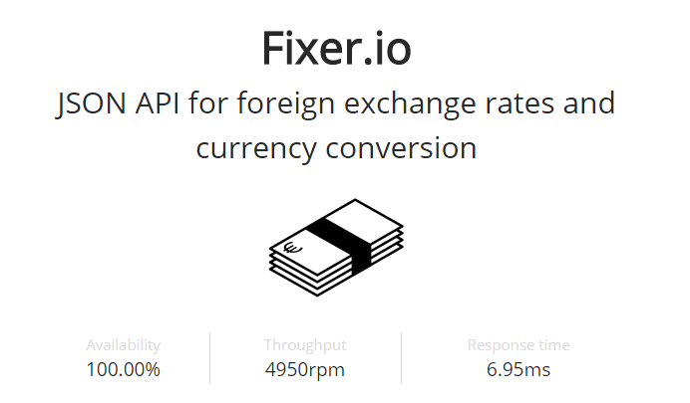
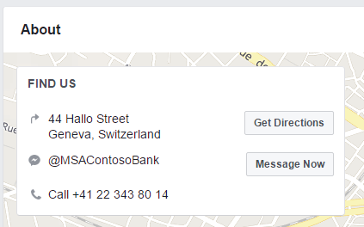
Currency Rates API – Fixer.io
No key required
JSON format
Rates published by the European Central Bank (Contoso Bank is located in Geneva, Switzerland)
Notes:
Advanced features…

Slide 4
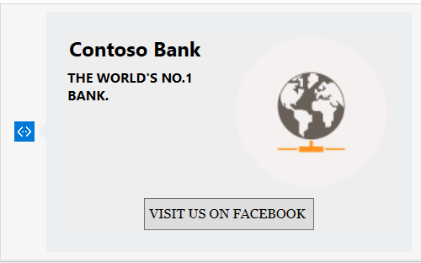
User Experience
Custom bank branding (Globe)
Sense of identity (Recognisable)
Matches slogan - “The world’s no.1 bank.”
Notes:
User Experience

Slide 5
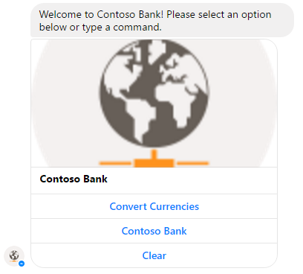
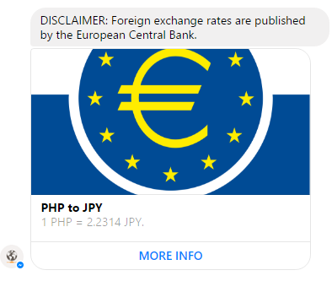
User Experience
Cards – Relevant UI
Buttons
Images
Visual presentation
Notes:
User Experience

Slide 6
User Experience/Additional Feature
Buttons for common commands and direct links.
Interaction with the bot other than just text
Ease of use
Efficiency
Notes:
User Experience

Slide 7
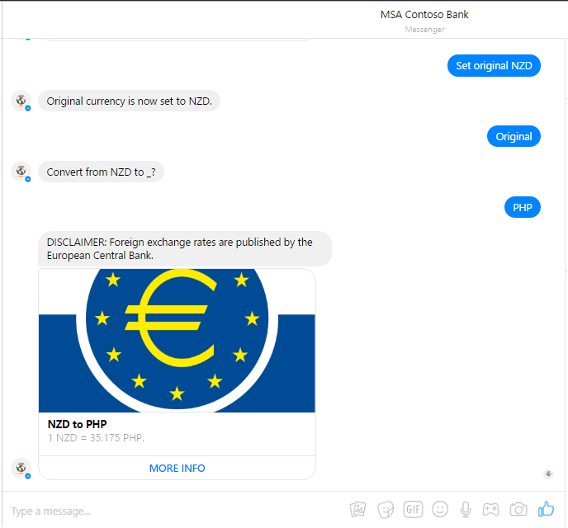
User Experience/Advanced Considerations
State service
Personalised experience
Setting default original currency
Notes:
User Experience

Slide 8
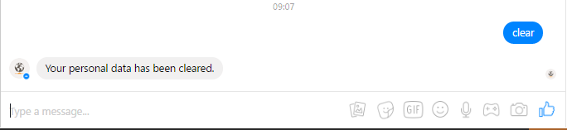
User Experience/Advanced Considerations
Published to a social media connection
Accessibility
Ease of use
Efficiency
Case in-sensitivity
User-friendly
Notes:
User Experience

Slide 9
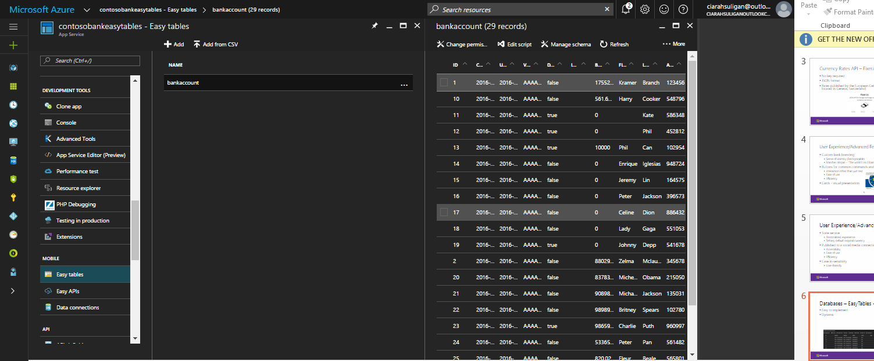
Databases – EasyTables + SQL
Easy to implement
Dynamic
Notes:
Talk about your database, what schema you used and what data you used

Slide 10
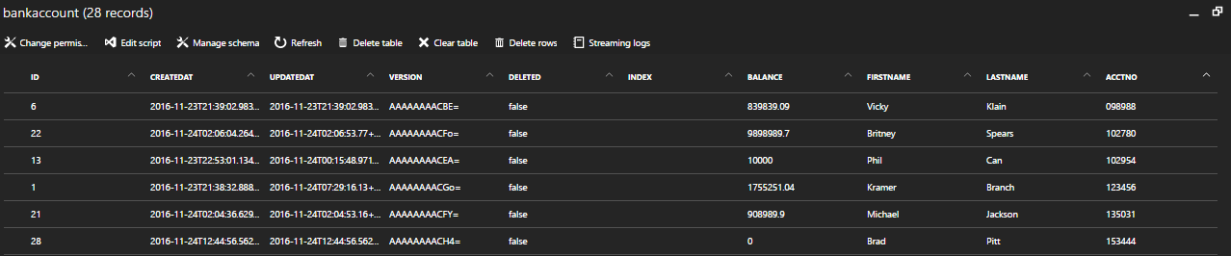
Databases – Data
Table Name: BankAccount
Primary Key: ID (Unique)
Assuming that once an account has been deleted, the same AcctNo could be assigned to another person.
Fields: ID, FirstName, LastName, AcctNo, Balance
Contoso Bank – bank accounts, deposits, withdrawals
Notes:
Talk about your database, what schema you used and what data you used

Slide 11
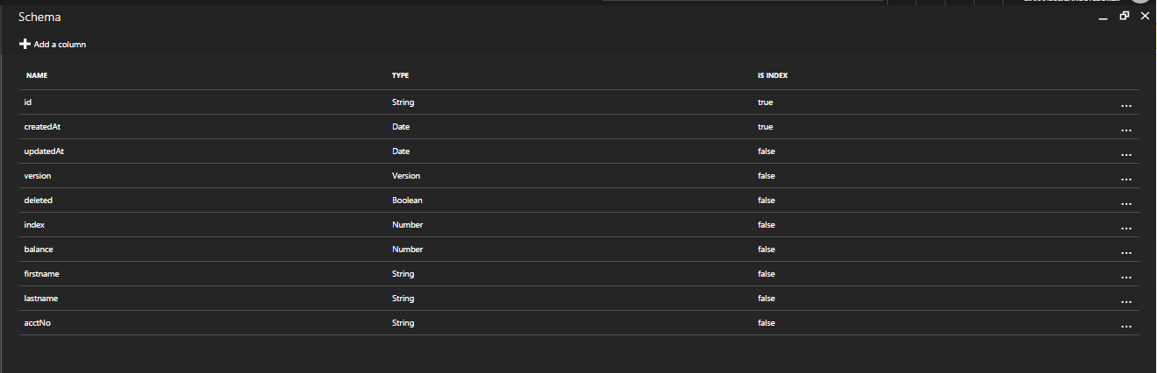
Databases – Schema
Schema
ID: String; Balance: Number(Double in C#); FirstName: String; LastName: StringAcctNo: String;
Notes:
Talk about your database, what schema you used and what data you used

Slide 12
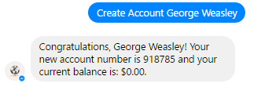
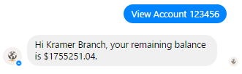
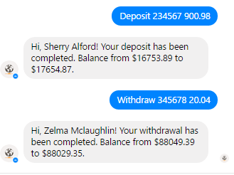
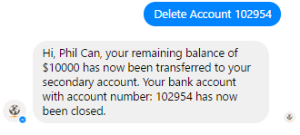
Databases - CRUD
Create – “Create Account”
Read – “View Account”
Update – “Deposit” / “Withdraw”
Delete – “Delete Account”
Notes:
Talk about your database, what schema you used and what data you used

Slide 13
Azure Setup
SQL Database + Server
Mobile app service (hosts database and implements EasyTables)
App service (runs Bot)

Slide 14

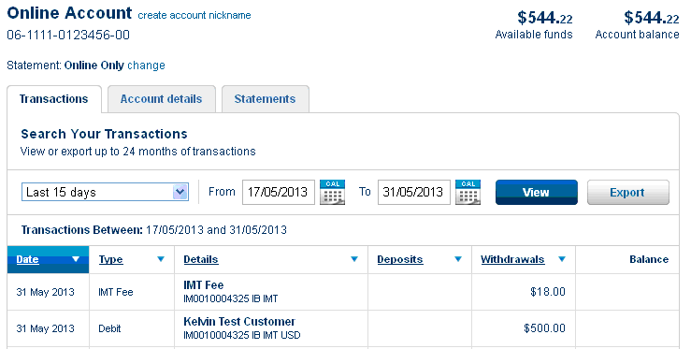
Final Comments Improvements to Consider
Databases
Store hashes instead of passwords for authentication
More user information
Additional APIs and Presentation
Stocks – carousel (Cards)

